Slide 1

Operating systems
I/O Management, System Protection and Security
Venkatesh Prasad
Department of Computer Science

Slide 2
Operating systems
System Protection – Implementation of Access Matrix, Access control, Access rights
Venkatesh Prasad
Department of Computer Science

Slide 3
OPERATING SYSTEMS
Slides Credits for all PPTs of this course
The slides/diagrams in this course are an adaptation, combination, and enhancement of material from the following resources and persons:
Slides of Operating System Concepts, Abraham Silberschatz, Peter Baer Galvin, Greg Gagne - 9th edition 2013 and some slides from 10th edition 2018
Some conceptual text and diagram from Operating Systems - Internals and Design Principles, William Stallings, 9th edition 2018
Some presentation transcripts from A. Frank – P. Weisberg
Some conceptual text from Operating Systems: Three Easy Pieces, Remzi Arpaci-Dusseau, Andrea Arpaci Dusseau

Slide 4
OPERATING SYSTEMS
Implementation of Access Matrix
Generally, a sparse matrix (i.e. most of the entries will be empty)
Option 1 – Global table
Store ordered triples <domain, object, rights-set> in table
A requested operation M on object O_{j} within domain D_{i} -> search table for a triple < D_{i} , O_{j} , R_{k} >
with M ∈ R_{k}
If triple found, operation is allowed to continue; otherwise an exception or condition is raised
But table could be large -> won’t fit in main memory
Virtual memory techniques can be used for managing this table
Difficult to group objects
consider an object that all domains can read, this object must have a separate entry in every domain)

Slide 5
OPERATING SYSTEMS
Implementation of Access Matrix (Cont.)
Option 2 – Access lists for objects
Each column implemented as an access list for one object i.e. specifying user names and the types of access allowed for each user (empty entries can be discarded)
Resulting per-object list consists of ordered pairs <domain, rights-set> defining all domains with non-empty set of access rights for the object
Easily extended to contain default set -> If M ∈ default set, also allow access
For efficiency, check the default set first and then search the access list

Slide 6
OPERATING SYSTEMS
Implementation of Access Matrix (Cont.)
Each column = Access-control list for one object Defines who can perform what operation Domain 1 = Read, Write Domain 2 = Read Domain 3 = Read
Each Row = Capability List (like a key) For each domain, what operations allowed on what objects
Object F1 – Read
Object F4 – Read, Write, Execute
Object F5 – Read, Write, Delete, Copy

Slide 7
OPERATING SYSTEMS
Implementation of Access Matrix (Cont.)
Option 3 – Capability list for domains
Instead of object-based (i.e column wise), list is domain based (i.e row wise)
Capability list for domain is list of objects together with operations allowed on them
Object represented by its name or address, called a capability
Execute operation M on object O_{j}, process requests operation and specifies capability as parameter
Possession of capability means access is allowed
Capability list associated with domain but never directly accessible to a process executing in that domain
Rather, protected object, maintained by OS and accessed by the user indirectly
Like a “secure pointer”
Idea can be extended up to the application level
Notes:
One way to partition the matrix is by rows. Thus we have all access rights of one user together. These are stored in a data structure called a capability list, which lists all the access rights or capabilities that a user has.
Ex: The following are the capability lists for 2 users Fred and Jane.
Fred --> /dev/console(RW)--> fred/prog.c(RW)--> fred/personal(RW) --> /usr/ucb/vi(X)
Jane --> /dev/console(RW)--> fred/prog.c(R)--> fred/personal() --> /usr/ucb/vi(X)

Slide 8
OPERATING SYSTEMS
Implementation of Access Matrix (Cont.)
Option 4 – Lock-key
Compromise between access lists and capability lists
Each object has a list of unique bit patterns, called locks
Each domain has a list of unique bit patterns called keys (managed by the OS)
Process in a domain can only access object if domain has a key that matches one of the locks
Notes:
As with capability lists, the list of keys for a domain must be managed by the operating system on behalf of the domain.
Users are not allowed to examine or modify the list of keys (or locks) directly.

Slide 9
OPERATING SYSTEMS
Comparison of Implementations
Many trade-offs to consider
Global table is simple, but can be large
Access lists correspond to needs of users
Access rights for a particular domain is non-localized, so difficult to determine the set of access rights for each domain
Every access to an object must be checked
Many objects and access rights -> slow (i.e not suitable for large system with long access lists)
Capability lists useful for localizing information for a given process
But revocation capabilities can be inefficient
Lock-key effective and flexible, keys can be passed freely from domain to domain, easy revocation

Slide 10
OPERATING SYSTEMS
Comparison of Implementations (Cont.)
Most systems use combination of access lists and capabilities
First access to an object -> access list searched
If allowed, capability created and attached to process
Additional accesses need not be checked
After last access, capability destroyed
Consider file system with ACLs per file recorded in a new entry in a file table (file table maintained by the OS such as UNIX and protection is ensured)

Slide 11
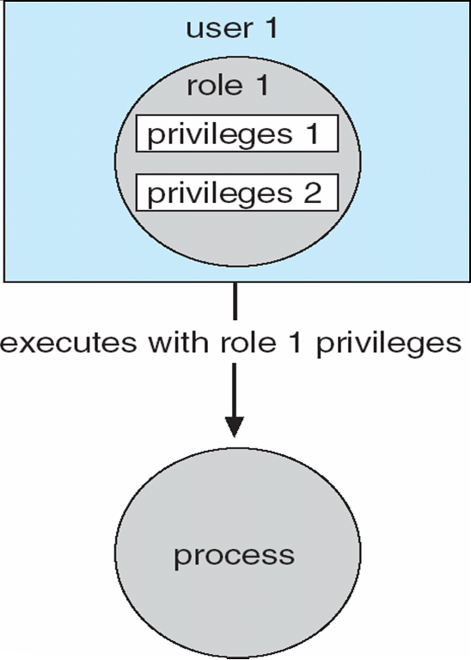
OPERATING SYSTEMS
Access Control
Protection can be applied to non-file resources
Oracle Solaris 10 provides role-based access control (RBAC) to implement least privilege
Privilege is right to execute system call or use an option (ex: write access for a file) within a system call
Can be assigned to processes
Users assigned roles granting access to privileges and programs
Enable role via password to gain its privileges
Similar to access matrix

Slide 12
OPERATING SYSTEMS
Revocation of Access Rights
Various options to remove the access right of a domain to an object
Immediate vs. delayed (i.e. when revocation will occur)
Selective vs. general (i.e. select group of users or all the users)
Partial vs. total (i.e. subset of the rights or all the rights)
Temporary vs. permanent (can access right be revoked and obtained later?)
Access List – Delete access rights from access list
Simple – search access list and remove entry, revocation is easy
Immediate, general or selective, total or partial, permanent or temporary

Slide 13
OPERATING SYSTEMS
Revocation of Access Rights (Cont.)
Capability List – Scheme required to locate capability in the system before capability can be revoked
Reacquisition – periodic delete from each domain, with reacquire and denial if revoked by a process
Back-pointers – set of pointers from each object to all capabilities of that object , follow these pointers for revocation (adopted in Multics)
Indirection – capability points to global table entry which in turn points to object – delete entry from global table, selective revocation not allowed
Keys – unique bit pattern associated with a capability, generated when capability is created
Master key associated with object, key matches master key for access
Revocation – create new master key (with a new value)
Policy decision of who can create and modify keys – object owner or others?

Slide 14

THANK YOU
Venkatesh Prasad
Department of Computer Science Engineering
venkateshprasad@pes.edu

